Slide 1

Powered By Professional Linguists
E-Mail: info@lingvopedia.com Web: www.lingvopedia.com

Slide 2
ABOUT US
LINGVOPEDIA is a language solutions provider company. We have over a decade experience in the field of language solutions, both in technical, as well as no-technical domains.
Our strength lies in our well-networked team of free-lancers and dedicated in-house resources, who continuously coordinates with our pool of intellectual man-power to ensure delivery of quality work with-in committed time-frame. Also, our friendship with technology ensures that the quality of work is not just accurate but also consistent.
LINGVOPEDIA is an ISO 9001-2015 certified company. However, this is not our bench-mark. It lies higher amongst a list of satisfied clients who speak well for our work. Eli Lilly, Anand & Anand, ICICI, UniteHere, Cambridge, Oxford Unersity Press, Deloitte, Airtel, Asos, Quora, Brics, Mahindra, NHSRC, J.K. Tyre, Honda and Jindal group to name a few.
We provide a wide forms of language solutions like translation, interpreting, voice-over, multi-lingual desktop publishing, transcription and other professional language services. We are a one-stop solution provider for all your language solutions.

Slide 3
ABOUT US
Since 2006
Founded by Mr. Rahul Malik, LINGVOPEDIA’s positive outlook is to make and create significant & positive difference in the overall language needs of our clients and to become an acclaimed market leader in the field of linguistic services.
Vision
Our vision is to make and create significant & positive difference in the overall needs of our Users and to become an acclaimed market leader in the field of language solution services.
Mission
Our mission is to train and engage people & resources of Lingvopedia in providing the highest standard and degree of linguistic solutions to its customers with consistent improvements.

Slide 4
SERVICES
We provide the following services in the field of language translation:
Professional Translation Services
Proof Reading and Editing Services
Multi-lingual DTP Services
Professional Interpretation Services
Translator Recruitment Services
Multi-lingual Transcription Services
Multi-lingual Subtitling Services
Multi-lingual Voiceover Services
Cultural and Language Training
INDIAN LANGUAGES
ASSAMESE | BENGALI | GUJARATI| HINDI | KANNADA | MALAYALAM | MARATHI| ORIYA| PUNJABI | TAMIL | TELUGU | URDU
ASIAN LANGUAGES
CHINESE | INDONESIAN | JAPANESE | KHMER | KOREAN | LAO | MALAGASY | NEPALESE | PUSHTO | SINHALESE | SORANI | SYLHETI | THAI
MIDDLE EAST & EASTERN EUROPEAN LANGUAGES
ALBANIAN | ARABIC | BULGARIAN | CROATIAN | CZECH | ESTONIAN | FARSI | HEBREW | HUNGARIAN | KURDISH | MONGOLIAN | POLISH | ROMANIAN | RUSSIAN | TAJIK | TURKISH| UZBEK
EUROPEAN LANGUAGES
DANISH | DUTCH | FINNISH | FRENCH | FLEMISH | GERMAN | GREEK | ICELANDIC | ITALIAN | MALTESE | PORTUGUESE | SPANISH| SWEDISH
AFRICAN LANGUAGES
AFRIKAANS | AMHARIC | SWAHALI | SOMALI | TWI | ZULU

Slide 5
OUR SEAMLESS TRANSLATION WORK-FLOW
WORK-ORDER & JOB RECEIVED FROM THE CLIENT
MANUAL TRANSLATION DONE BY TRANSLATORS
FILE RECEIVED AND REVIEWED BY LINGVOPEDIA
FILE SENT FOR ANOTHER ROUND OF PROOF-READING
- Source file is received from the client
- Files accepted in all formats including word, PDF, JPEG, DTP Open file or any other format, as required by the client
- File is sent to the translator in word format for translation
- LINGVOPEDIA uses only certified and trusted translators to maintain quality and ensure confidentiality of the document
- Type setting or formatting changes as-per the job-work requirement are done by a dedicated internal team
- Experts at LINGVOPEDIA provide utmost care and constant monitoring all through the process
- Type-set file is sent to a different translator
- Proof-reading by a different translator ensures elimination of all remaining errors (if any).
- Final translated file is delivered to the client
However, if client demands for further minor preferential changes, we always welcome the same without any extra charges up to 2 times
We also assist our clients with authorization formalities of the document on requests.
Tools That We Use
M. S Office Outlook
M. S. Office Word
M. S. Office Excel
M. S. Office PowerPoint
Adobe Software
Quark Express
CorelDraw
Any other software specified by the client on MAC or PC Platforms
TMS (Translation memory system)
PMS (Project management system)
CRM (Client relationship management)

Slide 6
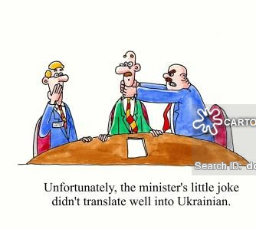
QUALITY ASSURANCE
At LINGVOPEDIA, we use a sophisticated integration of humans and technology to ensure that the essence of your document is never lost.
Translations done by softwares are literal and not always make sense of the actual thought.
You will NEVER have to land into a situation like this gentleman on the right.
LINGVOPEDIA is a certified ISO 9001-2015 certified company

Slide 7
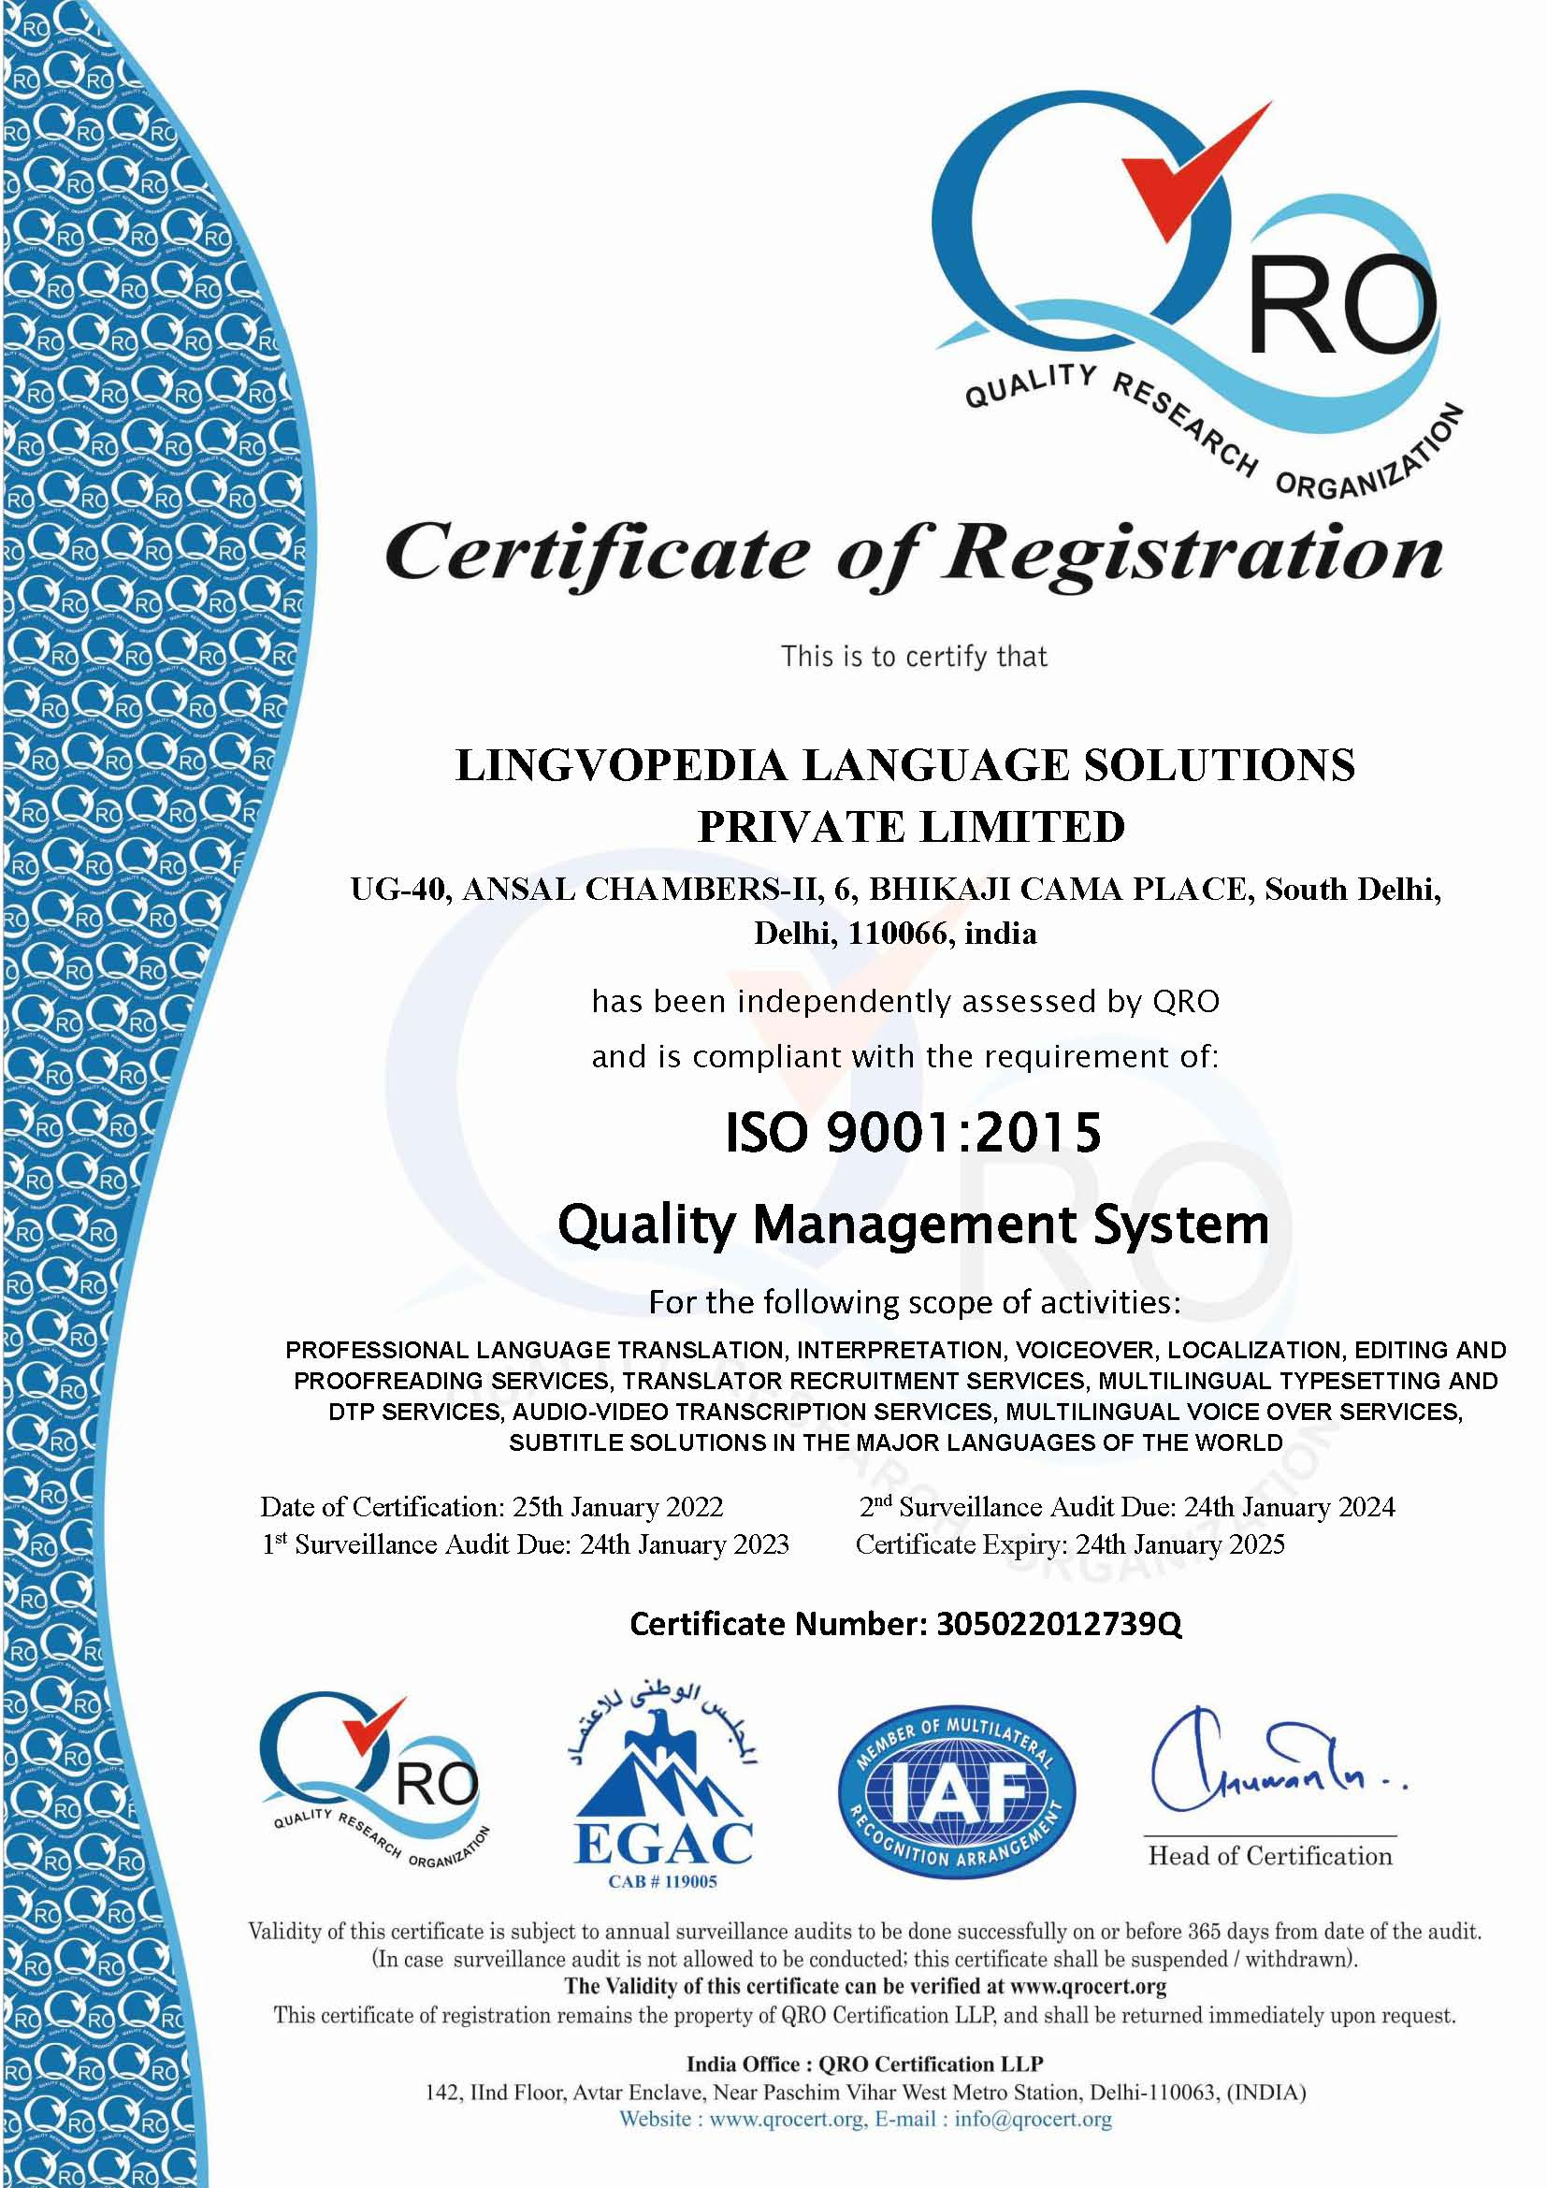
An ISO 9001-2015
CERTIFIED COMPANY
Selecting Professional Language Experts & Team
Each project is carefully assigned to professional language experts only by our carefully chosen in-house team. At Lingvopedia, the quality of work is screened and checked manually before beginning to provide any language service. We monitor each and every project with set guidelines as per the project and type of language service.
Recommending Second Linguist Review or Support
Two pairs of humans are better than one. Seeing the complexity of the documents and the budget, we tell our clients to go for proofreading services by a second translator. If the budget doesn’t allow, then we closely monitor feedback ratings left on translations by the client, which allow us to implement the changes on the translated file.
Implementing Technology
We strive to improve our quality by implementing new technologies related to our services. Simultaneously, we check each and every project to verify the solution is 100% human with maximum use of technology to provide fast and reliable language services.

Slide 8






























OUR CLIENTS
Advertisement & Market Research | Business & Aero Space | Legal & Certificates | Software & IT | Automotives & Aerospace | Education & Academics | Real Estate | Business & Finance | Medical & Scientific | Technical & Engineering
And many more. As the space is less…

Slide 9
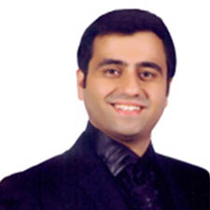
A WORD FROM THE MD
Dear Customer,
Greetings!
We are celebrating our 17th Anniversary this year. It is really going to be exciting with many new developments at LINGVOPEDIA and in the marketplace this financial year.
The language solutions industry is growing at a rapid pace and LINGVOPEDIA has recorded a community of language specialist in all major languages and also hard working human resources
who are making use of all the good technologies and methodologies available that will keep a check on the quality of the end solution.
Looking forward for your confidence in LINGVOPEDIA.
We will continue in our endeavor of creating significant positive difference in the overall language needs.
Regards,
Rahul Malik
(Managing Director)
Lingvopedia Language Solutions Pvt. Ltd.

Slide 10
THANK YOU
LINGVOPEDIA LANGUAGE SOLUTIONS PVT. LTD
UG 40, Ansal Chambers 2,
Bhikaji Cama Place,
New Delhi - 110066, India
Email : info@lingvopedia.com
Website: www.lingvopedia.com

